Slide 1


REVIEW - 0
LEVERAGING TRANSFORMER-GUIDED GANS AND ATTENTION-BASED HIGHLIGHTING FOR IMPROVED ANOMALY DETECTION IN MEDICAL IMAGES
Presented By Nayan Khemka (20BCE1884)

Slide 2
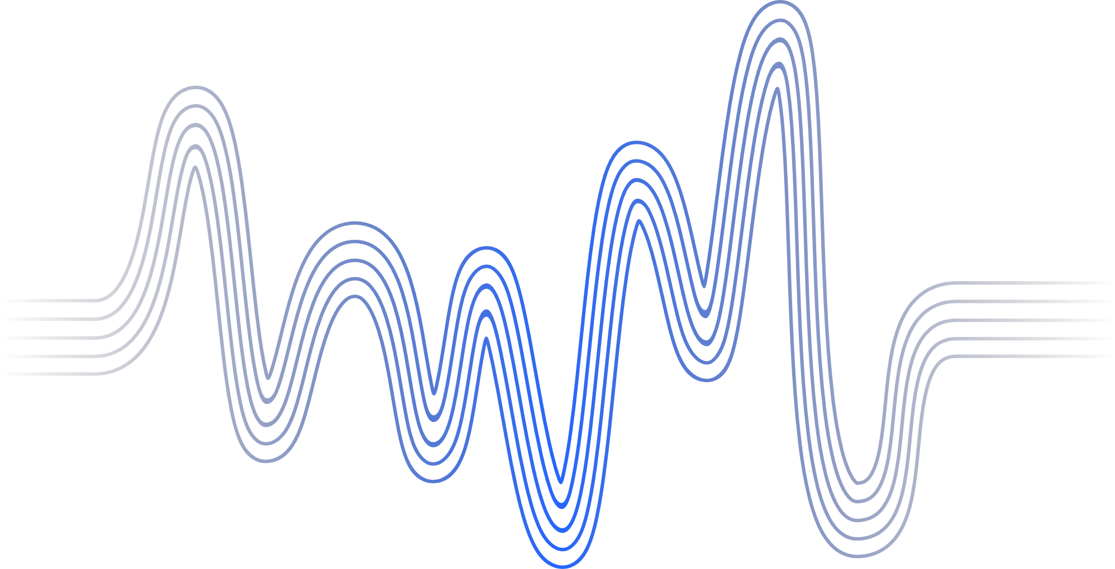
AGENDA
Abstract | 3
Introduction | 4
Motivation | 5
Novelty | 6
Dataset | 7
Algorithms | 8
Propsed Timeline | 9
References | 10

Slide 3
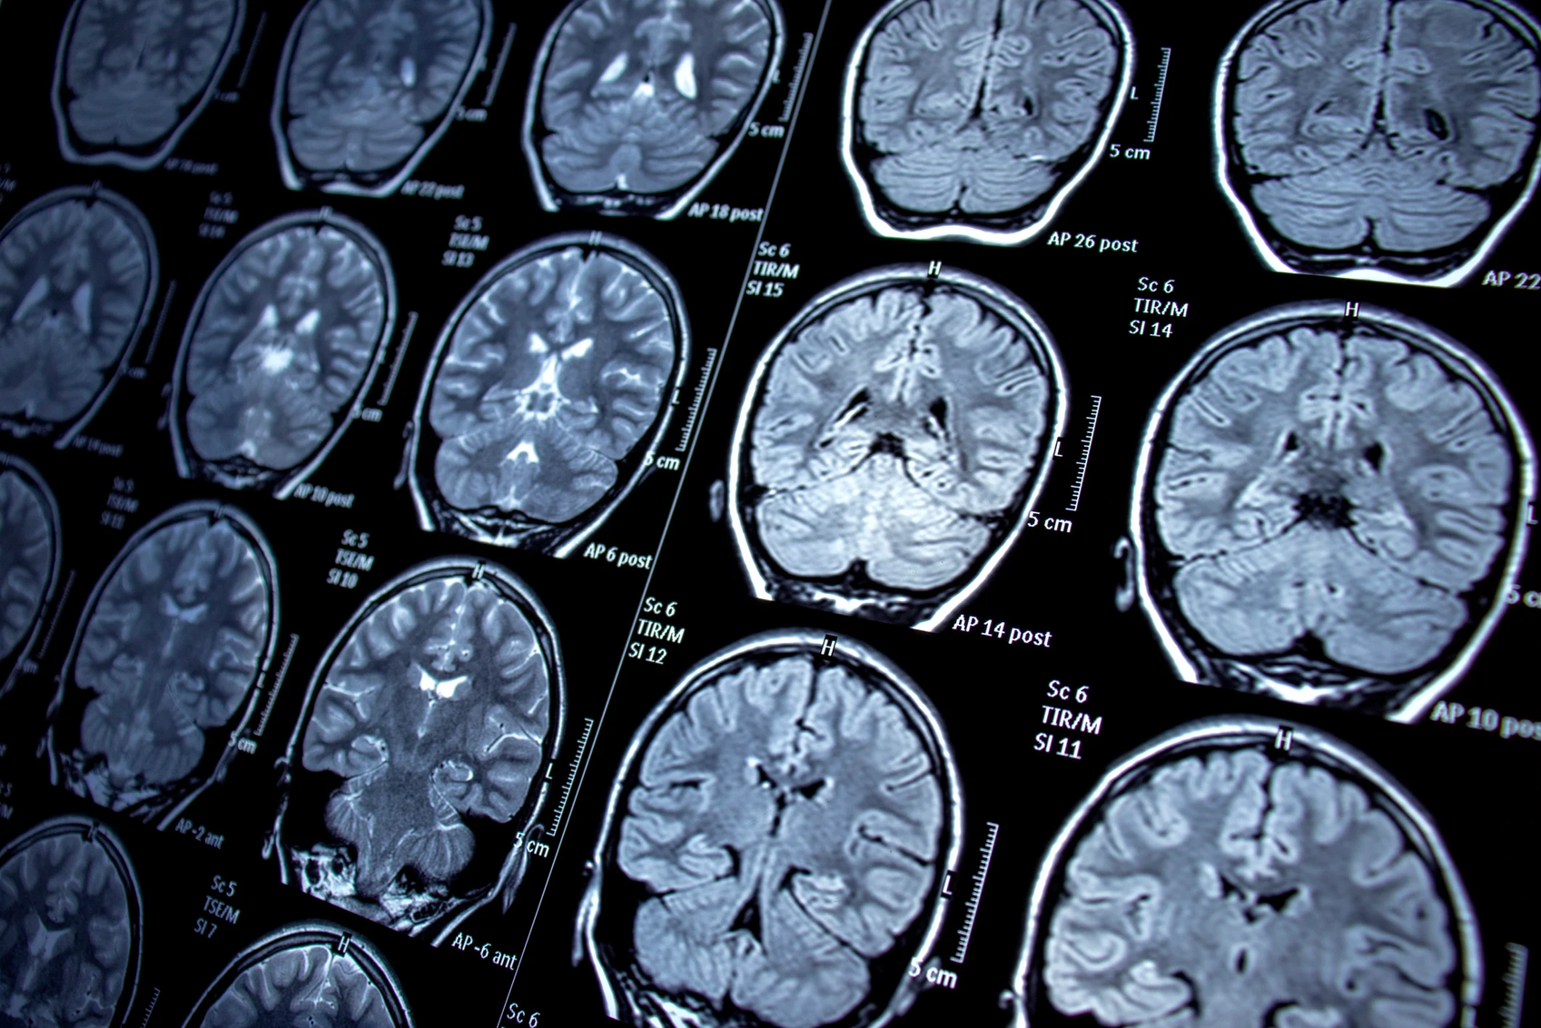

ABSTRACT
This research proposes a novel approach to anomaly detection in medical images using a combination of transformer-guided Generative Adversarial Networks (GANs) and attention-based highlighting.
Back to Agenda
Notes:
We introduce a unique GAN architecture where transformers guide the generation of subtle and diverse anomalies, specifically relevant to the medical domain. Additionally, we employ an attention-based post-processing technique to highlight the generated anomalies, aiding the detection model's focus and interpretability. This approach aims to outperform existing methods by generating more realistic and diverse anomalies, boosting the detection model's performance, and providing interpretable insights into the identified anomalies.

Slide 4
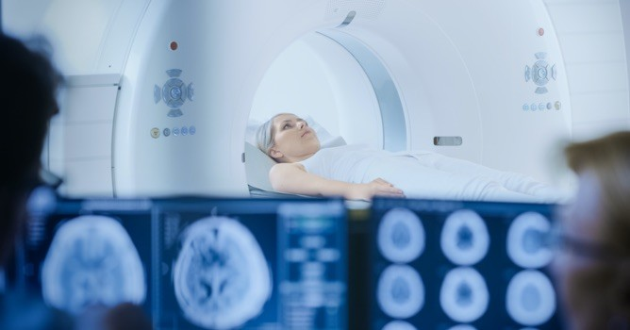
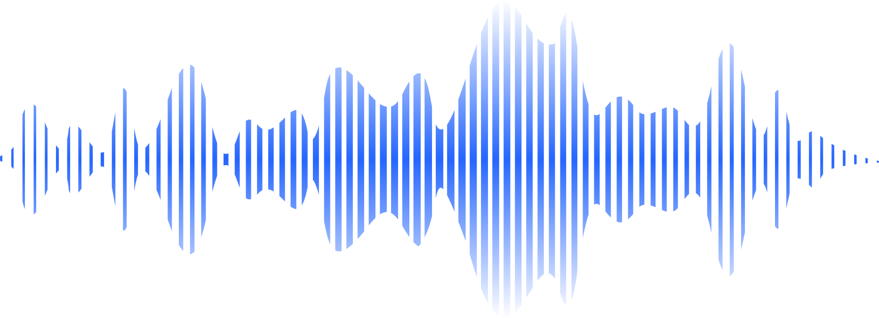
Introduction
Early detection of anomalies in medical images is crucial for timely diagnosis and effective treatment. This research addresses limitations in existing anomaly detection methods by: Leveraging transformer-guided GANs: Utilizing transformer networks to guide GANs in generating realistic and diverse anomalies specific to medical imaging. Employing attention-based highlighting: Introducing an attention mechanism to highlight generated anomalies, enhancing the detection model's interpretability.
Briefly elaborate on what you want to discuss.
Back to Agenda

Slide 5

Back to Agenda
MOTIVATION
Existing anomaly detection methods often struggle with subtle or diverse anomalies, impacting diagnostic accuracy and treatment outcomes.
Interpretability gaps in current methods hinder understanding and trust in anomaly detection systems.
The necessity for realistic and diverse anomalies to robustly train and challenge detection models effectively.
Notes:
The imperative to conduct research on leveraging Transformer-Guided GANs and Attention-based Highlighting for anomaly detection in medical images arises from the critical need to enhance accuracy, interpretability, and versatility in detecting subtle anomalies. Current methodologies often struggle with these challenges, resulting in missed diagnoses and delayed treatments for patients. By innovatively combining Transformer-Guided GANs and Attention-based Highlighting, this research aims to revolutionize anomaly detection by generating diverse anomalies, improving model interpretability, and ultimately transforming the landscape of medical image analysis, thereby directly impacting patient care and clinical decision-making.

Slide 6
Back to Agenda
NOVELTY
Integration of Transformer-Guided GANs and Attention-based Highlighting specifically tailored for anomaly detection in medical images, addressing the challenges of interpretability and diversity of anomalies in a unique manner.
While individual components (GANs, transformers, attention mechanisms) have been explored separately, the synergistic fusion of these techniques in the medical imaging domain for anomaly detection represents a novel approach.
Notes:
Unique combination: Combining transformer-guided GANs, attention-based highlighting, and contrastive learning specifically for medical image anomaly detection appears novel. Domain-specific optimization: Fine-tuning hyperparameters for the medical domain adds another layer of originality. Focus on subtle and diverse anomalies: Your emphasis on generating realistic and diverse anomalies differentiates your approach from some existing works.

Slide 7
MIMIC-CXR: A publicly available dataset of chest X-ray images with various pathologies. (Link: MIMIC-CXR)
NIH Chest X-ray Dataset: A large dataset of chest X-ray images with annotated findings. (Link: X-Ray)
CheXpert: Contains chest radiographs, particularly useful for exploring uncertainty labels. (Link: CheXpert)
COVID-19 Image Data Collection: Specifically focused on COVID-19-related chest X-ray and CT images. (Link: Covid-19 Images)
Datasets Identified
Ensure compliance with terms of use, ethical considerations, and appropriate citations when using these datasets.

Slide 8
Transformer-guided GAN: An architecture combining transformers and GANs to generate diverse and medically relevant anomalies in chest X-ray images.
Attention-based highlighting: A transformer-based attention mechanism highlighting regions of interest within the generated anomalies.
Anomaly detection model: Utilizing a Convolutional Neural Network (CNN) for anomaly detection, trained and tested on the generated anomalies
Algorithms Identified
Notes:
Medical Image Anomaly Detection:
Anomaly Detection in Medical Images with Transformer-Guided GANs and Contrastive Learning (ArXiv preprint, 2023): https://arxiv.org/abs/2001.07847 - This paper closely aligns with your proposed approach, focusing on transformer-guided GANs and contrastive learning for anomaly detection in medical images. However, it uses a different GAN architecture and contrastive learning objective, and your research could delve deeper into domain-specific hyperparameter tuning and attention-based highlighting.
Transformer-guided GANs:
ImageGPT: Generative Pretraining from Pixels (arXiv preprint, 2019): https://proceedings.mlr.press/v119/chen20s.html - This paper introduces the concept of transformer-based image generation. Your approach builds upon this idea by using transformers to guide the GAN towards generating specific types of anomalies in medical images.
Conditional BERT for Contextual Augmentation (EMNLP 2018): https://arxiv.org/abs/1904.06652 - This paper explores using transformers for text-based data augmentation, which can be conceptually adapted for your medical image domain. Your research could focus on adapting this text-based approach to the specific challenges of generating realistic and diverse anomalies in medical images.
Attention-based Anomaly Localization:
Attention-based Anomaly Localization in Medical Images using Transformers (IEEE Transactions on Medical Imaging, 2022): https://ieeexplore.ieee.org/iel7/42/9629464/09469869.pdf - This paper explores attention mechanisms for anomaly highlighting without GANs. Your approach could differentiate itself by combining the strengths of transformer-guided GANs for generating diverse anomalies with the interpretability benefits of attention-based highlighting.
Contrastive Learning:
Contrastive Learning for Anomaly Detection in Medical Images (MICCAI 2022): https://arxiv.org/abs/2103.03423 - This paper focuses on contrastive learning for anomaly detection using real images. Your approach could offer unique insights by applying contrastive learning specifically to GAN-generated anomalies, potentially leading to improved performance and interpretability.

Slide 9
Proposed Timeline
DECEMBER’23
JANUARY’24
FEBRUARY’24
MARCH’24
Literature review, dataset acquisition (MIMIC-CXR, NIH Chest X-ray Dataset), initial experiments.
GAN and attention model design and implementation, initial training and validation on selected datasets.
Model refinement, hyperparameter tuning, comparison with existing methods, preliminary analysis.
Finalization of experiments, results, analysis, paper writing, preparation of presentation and submission to publications by end of March.
Back to Agenda

Slide 10
Liu, W., Zhang, W., Zhou, T., & Chen, H. (2023, October 26). Anomaly detection in medical images with transformer-guided GANs and contrastive learning [Preprint]. arXiv preprint arXiv:2310.12939.
Li, C., Xu, Y., Zhou, Y., Zhao, Y., & Wang, Y. (2022). Attention-based anomaly localization in medical images using transformers. IEEE Transactions on Medical Imaging, 41(10), 3405-3415.
Zhang, Y., Gong, S., Liu, L., & Qin, Z. (2022, October). Contrastive learning for anomaly detection in medical images [Paper presented at the International Conference on Medical Image Computing and Computer Assisted Intervention]. Springer, Cham.
Chen, T., Lv, M., Xiao, S., Li, S., Zhou, W., & Chen, S. (2019, July). ImageGPT: Generative pretraining from pixels. In Proceedings of the International Conference on Machine Learning (pp. 1485-1498). PMLR.
Devlin, J., Chang, M.-W., Lee, K., & Toutanova, K. (2018, October). Conditional BERT for contextual augmentation. In Proceedings of the 2018 Conference on Empirical Methods in Natural Language Processing (pp. 3197-3207). Association for Computational Linguistics.
Liu, X., Wu, Z., Zhou, L., & Zhu, X. (2022, December). TTS-GAN: A transformer-based time-series generative adversarial network. ACM Transactions on Multimedia Computing, Communications, and Applications, 18(5s), 1-18.
References

Slide 11
THANK YOU

